Slide 1
Database
Lecture 05

Slide 2
Introduction
Good decisions require good information derived from raw facts
Data is managed most efficiently when stored in a database
Databases evolved from computer file systems
Understanding file system characteristics is important

Slide 3
Data vs. Information
Data: Data is raw, unorganized facts that need to be processed. Data can be something simple and seemingly random and useless until it is organized.
Example: Each student's test score is one piece of data.
Information: When data is processed, organized, structured or presented in a given context so as to make it useful, it is called information.
Example: The average score of a class or of the entire school is information that can be derived from the given data.

Slide 4
Introducing the Database
Database: shared, integrated computer structure that stores a collection of:
End-user data: raw facts of interest to end user
Metadata: data about data
Provides description of data characteristics and relationships in data
Complements and expands value of data

Slide 5
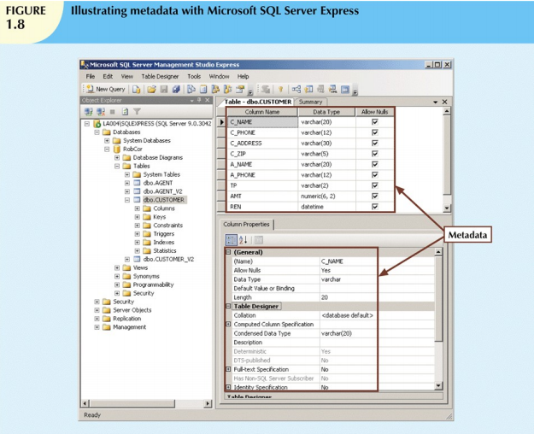

Slide 6
The Database
Fields
Hold an individual piece of data
Are named descriptively
Often called a column
Phone book examples
Name, address, e-mail, phone number
Fields may contain no data
Records
One full set of fields
Often called a row
Phone book example
Smith, Joe, 123 Some Street, 412-555-7777
Databases may have unlimited rows
Tables
One complete collection of records
Databases may have thousands of tables

Slide 7
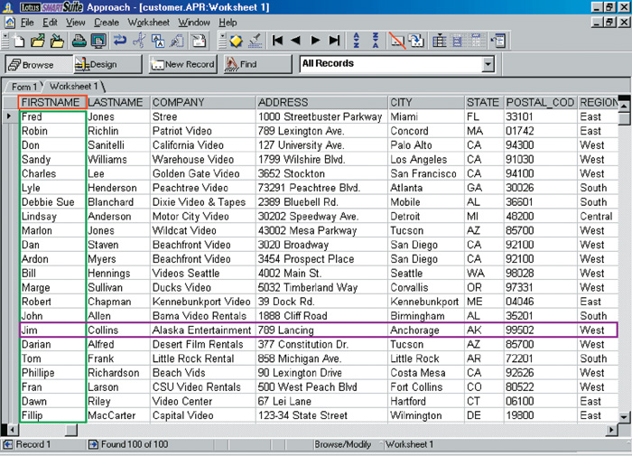
Database Structure
Field Name
Field
Record

Slide 8
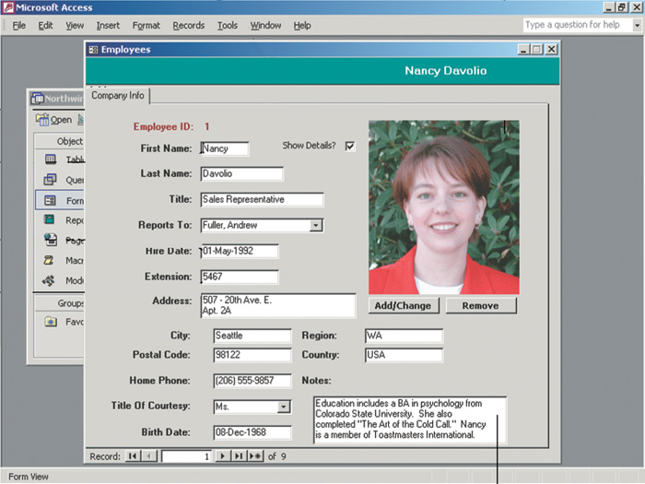
Database Helper Documents
Forms
Present one record to the user
Often used to change or view data
Reports
Produce printed results from the database
Includes tools to summarize data

Slide 9
Flat-file Databases
Typically has only one table
If multiple, each has a separate file
Useful for simple data storage needs
Hard to manage large data needs
Can waste disk space

Slide 10
Relational Databases
Made of two or more tables
Tables are related by a common field
Called a relationship or join
Can help organize data
Most common form of database
Maintaining data is easier than flat-file
No wasted disk space

Slide 11
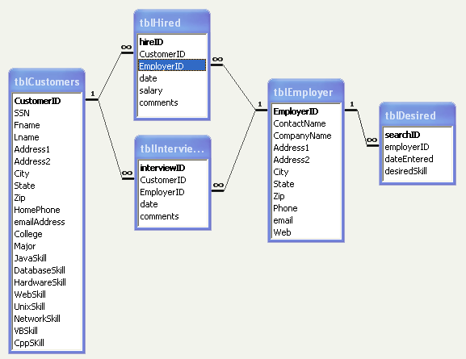
ER Diagram

Slide 12
Types of Databases(User)
Databases can be classified according to:
Number of users
Database location(s)
Expected type and extent of use
Single-user database A database located on a single computer and designed to be accessed by a single user.
Desktop database: single-user; runs on PC
Multiuser database A database designed to be accessed by multiple users.
Workgroup and enterprise databases

Slide 13
Types of Databases(Location)
Centralized database: A database system in which all of the data used by the system is located on a single computer.
Distributed database: A database system in which the data used by the system is located on multiple computers that are connected via a network.

Slide 14
Types of Databases(Usage)
Operational database: Supports a company’s day-to-day operations. An operational database query allows to read and modify operations. An operational database maintains current data.
Data warehouse: Stores data used for tactical or strategic decisions. While an OLAP query needs only read only access of stored data. On the other hand, a data warehouse maintains historical data.

Slide 15
Types of Databases (Data)
Unstructured data: Unstructured data has no pre-defined format or organization, making it much more difficult to collect, process, and analyze.
Structured data: Structured data is highly-organized and formatted in a way so it's easily searchable in relational databases.
Semi structured data: Semi-structured data is information that does not reside in a rational database but that have some organizational properties that make it easier to analyze.
Extensible Markup Language (XML): Represents data elements in textual format
XML database supports semi structured XML data

Slide 16
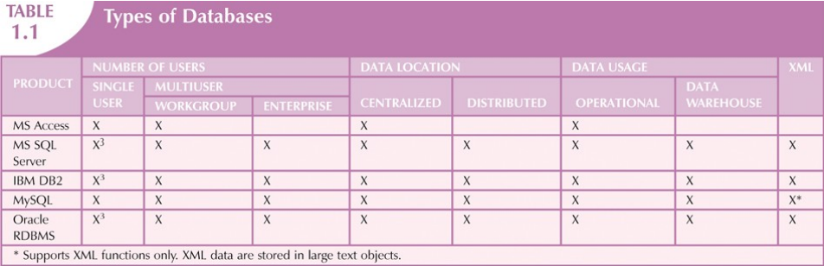

Slide 17
Why Database Design Is Important?
Database design focuses on design of database structure used for end-user data
Designer must identify database’s expected use
Well-designed database:
Facilitates data management
Generates accurate and valuable information
Poorly designed database:
Causes difficult-to-trace errors

Slide 18
File System in Database
Reasons for studying file systems:
Complexity of database design is easier to understand
Understanding file system problems helps to avoid problems with DBMS systems
Knowledge of file system is useful for converting file system to database system
File systems typically composed of collection of file folders, each tagged and kept in cabinet
Organized by expected use

Slide 19
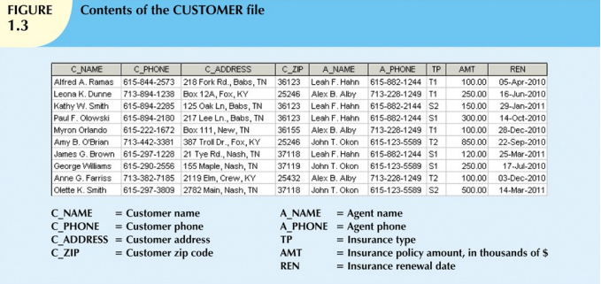

Slide 20
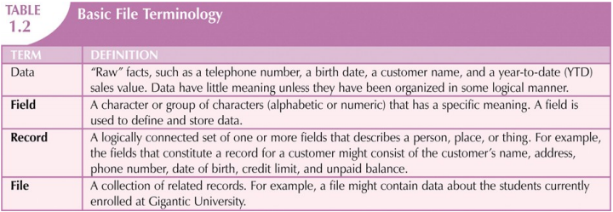
Basic File Terminology

Slide 21
Problems with File System Data
File system structure makes it difficult to combine data from multiple sources
Organizational structure promotes storage of same data in different locations
Data stored in different locations is unlikely to be updated consistently
Data redundancy: same data stored unnecessarily in different places
Data inconsistency: different and conflicting versions of same data occur at different places
Data anomalies: abnormalities when all changes in redundant data are not made correctly
Update anomalies
Insertion anomalies
Deletion anomalies

Slide 22
Database Systems
Database system consists of logically related data stored in a single logical data repository
May be physically distributed among multiple storage facilities
DBMS eliminates most of file system’s problems
Current generation stores data structures, relationships between structures, and access paths
Also defines, stores, and manages all access paths and components

Slide 23
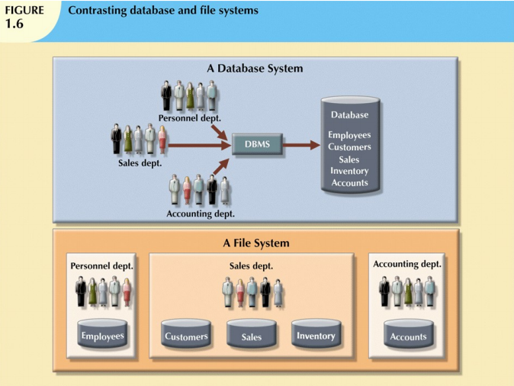

Slide 24
The Database System Environment
Database system: defines and regulates the collection, storage, management, use of data
Five major parts of a database system:
Hardware
Software
People
Procedures
Data

Slide 25
The Database System Environment
Hardware: all the system’s physical devices
Software: three types of software required:
Operating system software
DBMS software
Application programs and utility software
People: all users of the database system
System and database administrators
Database designers
Systems analysts and programmers
End users
Procedures: instructions and rules that govern the design and use of the database system
Data: the collection of facts stored in the database
Database systems are created and managed at different levels of complexity
Database solutions must be cost-effective as well as tactically and strategically effective
Database technology already in use affects selection of a database system

Slide 26
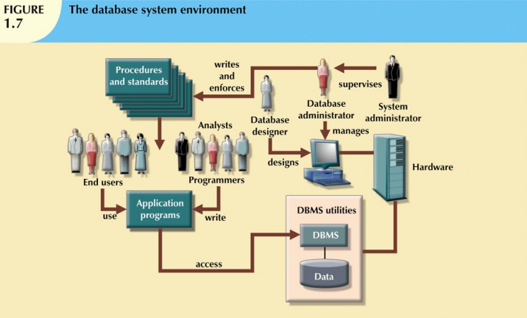

Slide 27
Database Management Systems(DBMS)
A database management system (DBMS) is a software package designed to define, manipulate, retrieve and manage data in a database. A DBMS generally manipulates the data itself, the data format, field names, record structure and file structure. It also defines rules to validate and manipulate this data.
Programs that control the database
Allows
Entering data
Querying data
Printing reports
Supports thousands of users
Includes tools to protect the data
Database management system (DBMS)
Store large collections of data
Organize the data
Becomes a data storage system

Slide 28
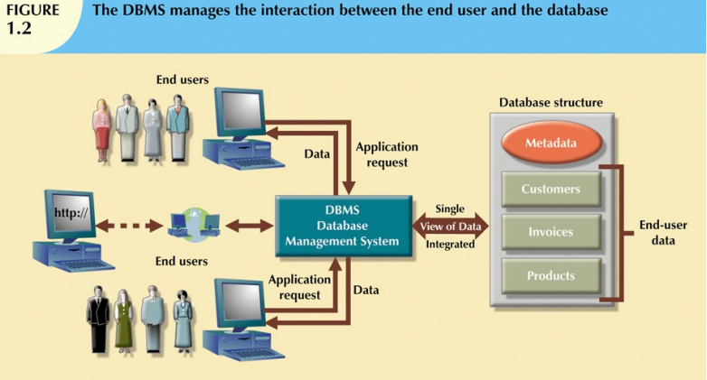

Slide 29
Functions of DBMS
Following are the functions of DBMS.
Data dictionary management
Data storage management
Data transformation and presentation
Security management
Multiuser access control
Backup and recovery management
Data integrity management
Provide access to languages

Slide 30
Functions of DBMS
1. Data dictionary management:
DBMS stores definitions of data elements and relationships (metadata) in a data dictionary
DBMS looks up required data component structures and relationships
Changes automatically recorded in the dictionary
DBMS provides data abstraction and removes structural and data dependency

Slide 31
Functions of DBMS
2. Data storage management
DBMS creates and manages complex structures required for data storage
Also stores related data entry forms, screen definitions, report definitions, etc.
Performance tuning: activities that make the database perform more efficiently
DBMS stores the database in multiple physical data files

Slide 32
Functions of DBMS
3. Data transformation and presentation
DBMS transforms data entered to conform to required data structures
DBMS transforms physically retrieved data to conform to user’s logical expectations
4. Security management
DBMS creates a security system that enforces user security and data privacy
Security rules determine which users can access the database, which items can be accessed, etc.

Slide 33
Functions of DBMS
5. Multiuser access control
DBMS uses sophisticated algorithms to ensure concurrent access does not affect integrity
6. Backup and recovery management
DBMS provides backup and data recovery to ensure data safety and integrity
Recovery management deals with recovery of database after a failure
Critical to preserving database’s integrity

Slide 34
Functions of DBMS
7. Data integrity management
DBMS promotes and enforces integrity rules
Minimizes redundancy
Maximizes consistency
Data relationships stored in data dictionary used to enforce data integrity
Integrity is especially important in transaction-oriented database systems

Slide 35
Functions of DBMS
8. Provide access to languages:
DBMS provides access through a query language
Query language is a nonprocedural language
Structured Query Language (SQL) is the de facto query language
Standard supported by majority of DBMS vendors

Slide 36
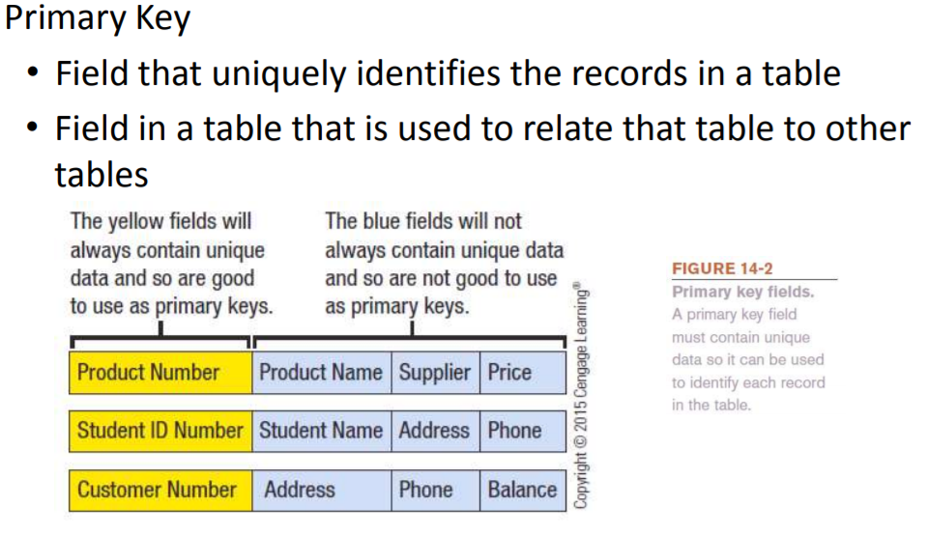
Primary Key

Slide 37
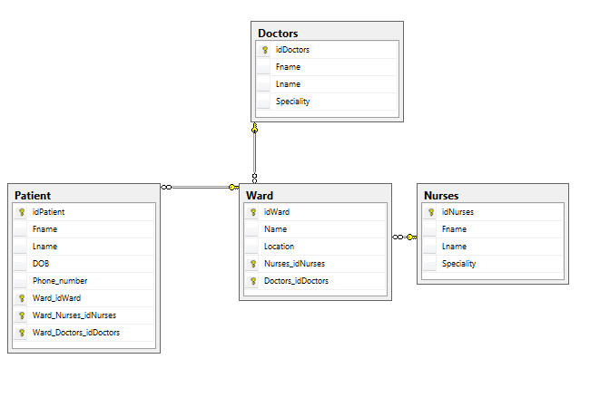
Primary Key Example
Primary key, is a key in a relational database that is unique for each record.

Slide 38
SQL Commands
These SQL commands are mainly categorized into four categories as:
DDL – Data Definition Language
CREATE – is used to create the database or its objects (like table, index, function, views, store procedure and triggers).
DROP – is used to delete objects from the database.
ALTER-is used to alter the structure of the database.
DQL – Data Query Language
SELECT – is used to retrieve data from the a database.
DML – Data Manipulation Language
INSERT – is used to insert data into a table.
UPDATE – is used to update existing data within a table.
DELETE – is used to delete records from a database table.
DCL – Data Control Language
GRANT-gives user’s access privileges to database.
REVOKE-withdraw user’s access privileges given by using the GRANT command.

Slide 39
Query Examples
Selecting individual columns of data from table:
Syntax:
SELECT column1, column2, ... FROM table_name;
Example:
SELECT FirstName, LastName, City
FROM Customers;
Selecting all columns of data from table:
Syntax:
SELECT *
FROM table_name;
Example:
SELECT *
FROM Customers;

Slide 40
Query Examples
Selecting data from table using where condition:
Syntax:
SELECT column1, column2, ... FROM table_name
WHERE condition;
Example:
SELECT FirstName, LastName, City
FROM Customer
WHERE State = 'NY';
Example:
SELECT FirstName, LastName, City
FROM Customer
WHERE State = 'NY’ or ‘TX’;
Example:
SELECT FirstName, LastName, City
FROM Customers
WHERE State = 'NY’ AND Creditlimit = 2000;

Slide 41
Query Examples
Order By:
Syntax:
SELECT column1, column2, ... FROM table_name ORDER BY column1, column2, ... ASC|DESC;
Example:
SELECT FirstName, LastName, City
FROM Customer
Order By FirstName DESC;
IS NULL:
Syntax:
SELECT column_names FROM table_name WHERE column_name IS NULL;
Example:
SELECT FirstName, LastName, City
FROM Customer
WHERE PostalCode is NULL;

Slide 42
Query Examples
Min():
Syntax:
SELECT MIN(column_name) FROM table_name WHERE condition;
Example:
SELECT MIN(CreditLimit)
FROM Customer;
Max():
Syntax:
SELECT MAX(column_name) FROM table_name WHERE condition;
Example:
SELECT MAX(CreditLimit)
FROM Customer;

Slide 43
Query Examples
Count():
Syntax:
SELECT Count(column_name) FROM table_name WHERE condition;
Avg():
Syntax:
SELECT Avg(column_name) FROM table_name WHERE condition;
Sum():
Syntax:
SELECT Sum(column_name) FROM table_name WHERE condition;

Slide 44
Query Examples
In:
Syntax:
SELECT column_name(s) FROM table_name WHERE column_name IN (value1, value2, ...);
Example:
SELECT FirstName, LastName, City
FROM Customer
WHERE State in (‘NY’,’TX’);
Between:
Syntax:
SELECT column_name(s) FROM table_name WHERE column_name BETWEEN value1 AND value2;
Example:
SELECT *
FROM Customer WHERE CreditLimit BETWEEN 1000 AND 1500;
SELECT *
FROM Customer As c
where c.customersince BETWEEN #01-Jan-2010# and #01-Jan-2015#;

Slide 45
Query Examples
UNION: (Doesn’t allow duplicate)
Syntax:
SELECT column_name(s) FROM table1 UNION SELECT column_name(s) FROM table2;
UNION All: (Allows duplicates)
Syntax:
SELECT column_name(s) FROM table1 UNION ALL SELECT column_name(s) FROM table2;

Slide 46
Query Examples
Column Aliases:
Syntax:
SELECT column_name AS alias_name FROM table_name;
Example:
SELECT FirstName As n, LastName As l, City As c
FROM Customer;

Slide 47
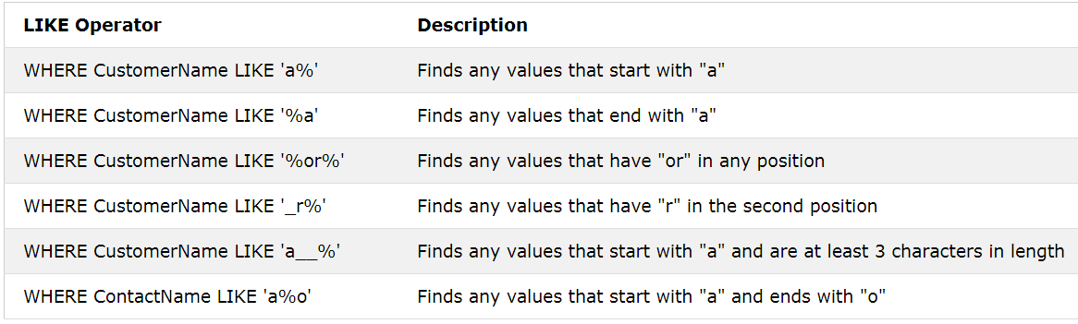
Query Examples
IS Like
Syntax:
SELECT column1, column2, ... FROM table_name WHERE columnN LIKE pattern;
Syntax:
SELECT *
from Employee As e
where e.FirstName like "A*"

Slide 48
Query Examples
Group by
Syntax:
SELECT column_name(s) FROM table_name WHERE condition GRUP BY column_name(s)
Example:
SELECT state, count(customerID) As Counts
from Customer
group by State;

Slide 49
Questions
Select all the customers who are not from united states?
Select all the customers who’s country are not given?
Select all the customers who’s don’t have any discount?
Provide name, address, city and country who’s are American but don’t have county mentioned?
Provide Name, City, State, Phone Number of those customers who’s credit limit is above $1000?
Provide Name, Phone Number of those customers who’s credit limit is null?

Slide 50
Different Types of SQL JOINs
Here are the different types of the JOINs in SQL:
(INNER) JOIN: Returns records that have matching values in both tables
LEFT (OUTER) JOIN: Returns all records from the left table, and the matched records from the right table
RIGHT (OUTER) JOIN: Returns all records from the right table, and the matched records from the left table
FULL (OUTER) JOIN: Returns all records when there is a match in either left or right table

Slide 51
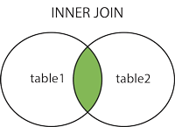
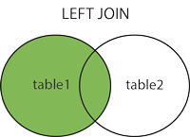
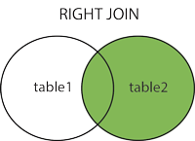
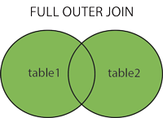
Different Types of SQL JOINs

Slide 52
Different Types of SQL JOINs
SELECT column_name(s) FROM table1 INNER JOIN table2 ON table1.column_name = table2.column_name;
SELECT *
FROM Customer inner join Employee
ON Customer.CustomerID=Employee.EmployeeID;

Slide 53
Different Types of SQL JOINs
SELECT column_name(s) FROM table1 LEFT JOIN table2 ON table1.column_name = table2.column_name;
SELECT *
FROM Customer
LEFT JOIN Employee
ON Customer.CustomerID=Employee.EmployeeID;

Slide 54
Different Types of SQL JOINs
SELECT column_name(s) FROM table1 RIGHT JOIN table2 ON table1.column_name = table2.column_name;
SELECT *
FROM Customer
RIGHT JOIN Employee
ON Customer.CustomerID=Employee.EmployeeID;

Slide 55
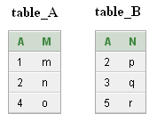
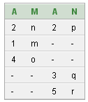
Different Types of SQL JOINs
SELECT column_name(s) FROM table1 FULL OUTER JOIN table2 ON table1.column_name = table2.column_name;
SELECT *
FROM table_A
FULL OUTER JOIN table_B
ON table_A.A=table_B.A;

Slide 56
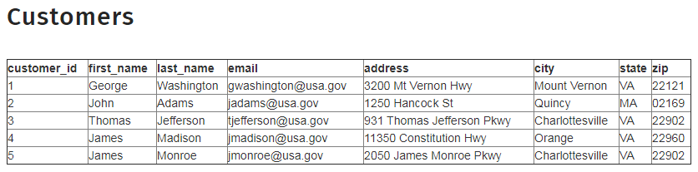
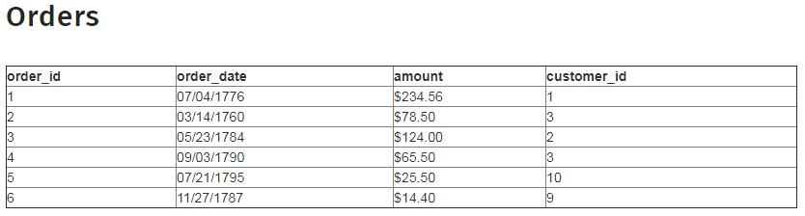
Sample tables
Question: Write query to pull the record of person living in Charlottesville?
Question: Write query to pull the all order placed in 3rd qtr of year?
Question: Write query to pull the record of lowest amount order?
Question: Write query to pull the customer with most orders?

Slide 57
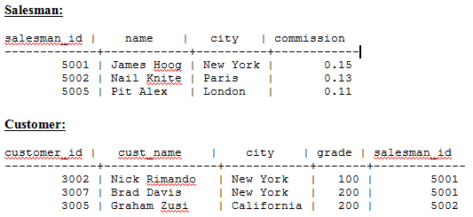
Example Tables
Question: Write a query to pull a list with salesman name, customer name and their cities for the salesmen and customer who belongs to the same city.

